Slide 1
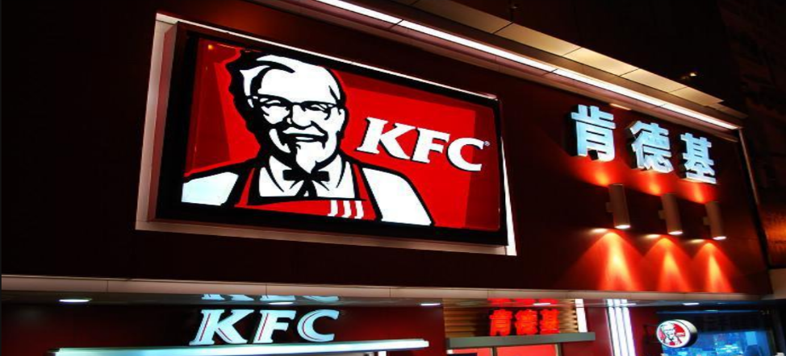
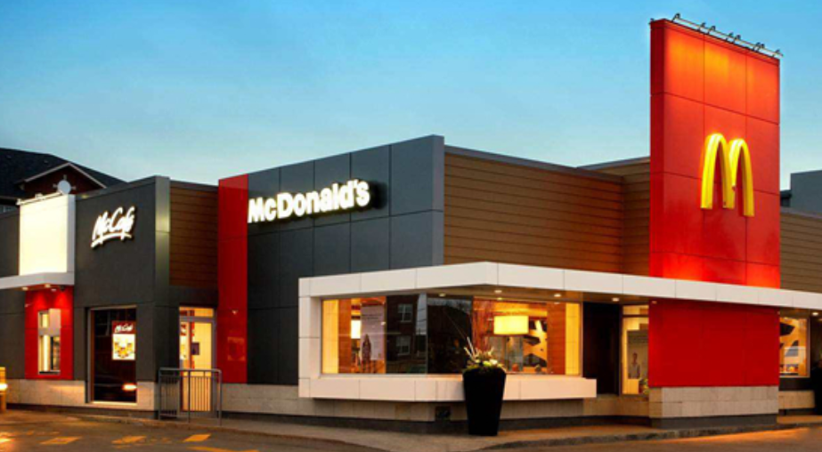
K F C
MacDonald’s
1

Slide 2
Differences
History
KFC is part of Yum! Brands, Inc., the world's largest restaurant company in terms of system restaurants, with more than 36,000 locations around the world. Today, the Colonel's spirit and heritage are reflected in KFC's brand identity.
In 1954, Ray Kroc discovered a small burger restaurant in California, and wrote the first page of McDonald's history. From that humble start as a small restaurant in Des Plaines, Illinois in 1955, we’re proud to have become one of the world’s leading quick service restaurant.
Development in Hongkong
KFC has over 60 branches throughout the territory with a team of more than 3,000 employees and serves over 1.5 million customers each month. Of the menu offered, the Original Recipe, BBQ Honey Wings, Zinger Burger, Mushroom Rice and Egg Tart are the most popular KFC tastes.
1975, the first McDonald's in opened on Paterson Street, Causeway Bay. There are around 235 McDonald's Restaurants in Hong Kong, employing more than 15,000 McDonald's staff. And we are committed to offer a pleasant dining experience to every customer.
2

